Slide 1
UberCasino – Dealer Version
Group 3 – Michael Teixeira & Kyle Teixeira

Slide 2
Project Progression
SLOC
Requirements
End of Design and implementation
16292 SLOC
End of Test Phase
17322 SLOC
Requirements Phase
103 Reqs total
Design and Implementation
65 Reqs total
Deleted 44 reqs
Added 6 Reqs
Test Phase
62 Total
Deleted 3 reqs
Added 0 reqs

Slide 3
Project Progression
Requirements
Requirements Phase
103 Reqs total
Design and Implementation
65 Reqs total
Test Phase
62 Total

Slide 4
Project Difficulty
Open Splice
Figuring out how to send and receive information
Multi-Threading
Issues with the GUI required the use of threads to resolve
FLTK with multiple files
So many linker errors

Slide 5
Working as a group
Scheduling
Roommates
No problems meeting up to talk about the project
Problems
When one members task requires the others to be completed
Work flow
Split coding up by files to avoid merge conflicts
Used Bit Bucket for version control

Slide 6
Michael’s Take
Spending more time on the design would have speed up the development process
Practice debugging someone else's code
Diagrams are hugely helpful during implementation for big projects
Enjoyed designing the GUI
Communication is key

Slide 7
Kyle’s Take
Multi-threaded code will cause race conditions, contrary to their name, they are not fun to chase around.
Great learning experience for event driven code.
Full understanding of the system is key, even if you are only working on a portion.
Start a project ahead of time, so we have time to realize our Time Needed Estimate was way off.
Global Variables are not as evil as 1310 made them out to be.
Determining the relevance of all Classes in the design phase can make the implementation quicker and more clear.

Slide 8
Dealer vs Player
Have not gotten the opportunity to test against another groups program as all the players who we got information for have said they are not ready. The following are screen shots playing with our own dummy player as well as examples of the test scenarios running with 7 hard-coded dummy players.

Slide 9
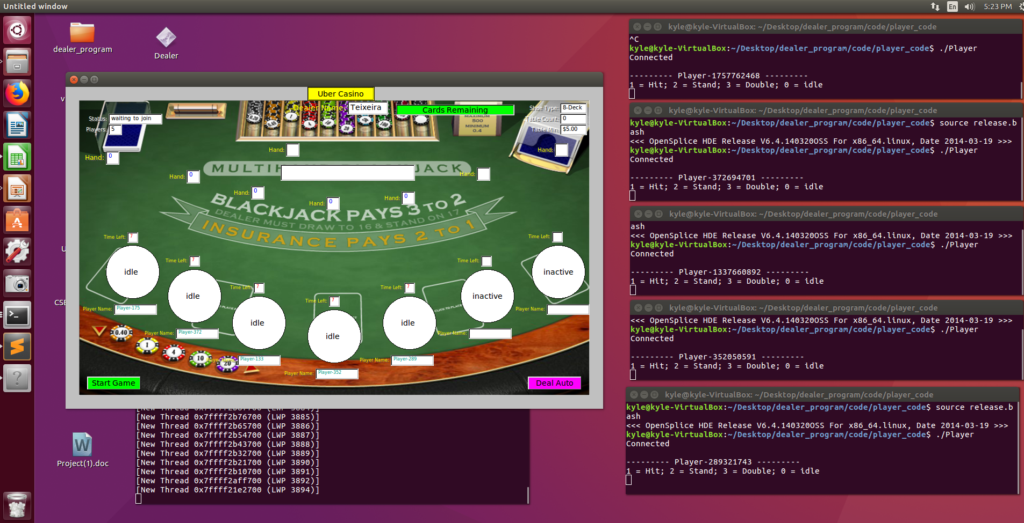
Dealer vs Player

Slide 10
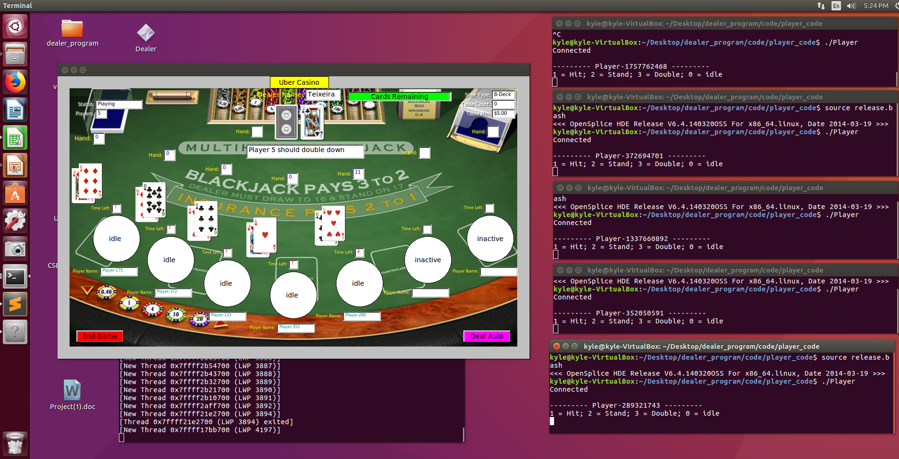
Dealer vs Player

Slide 11
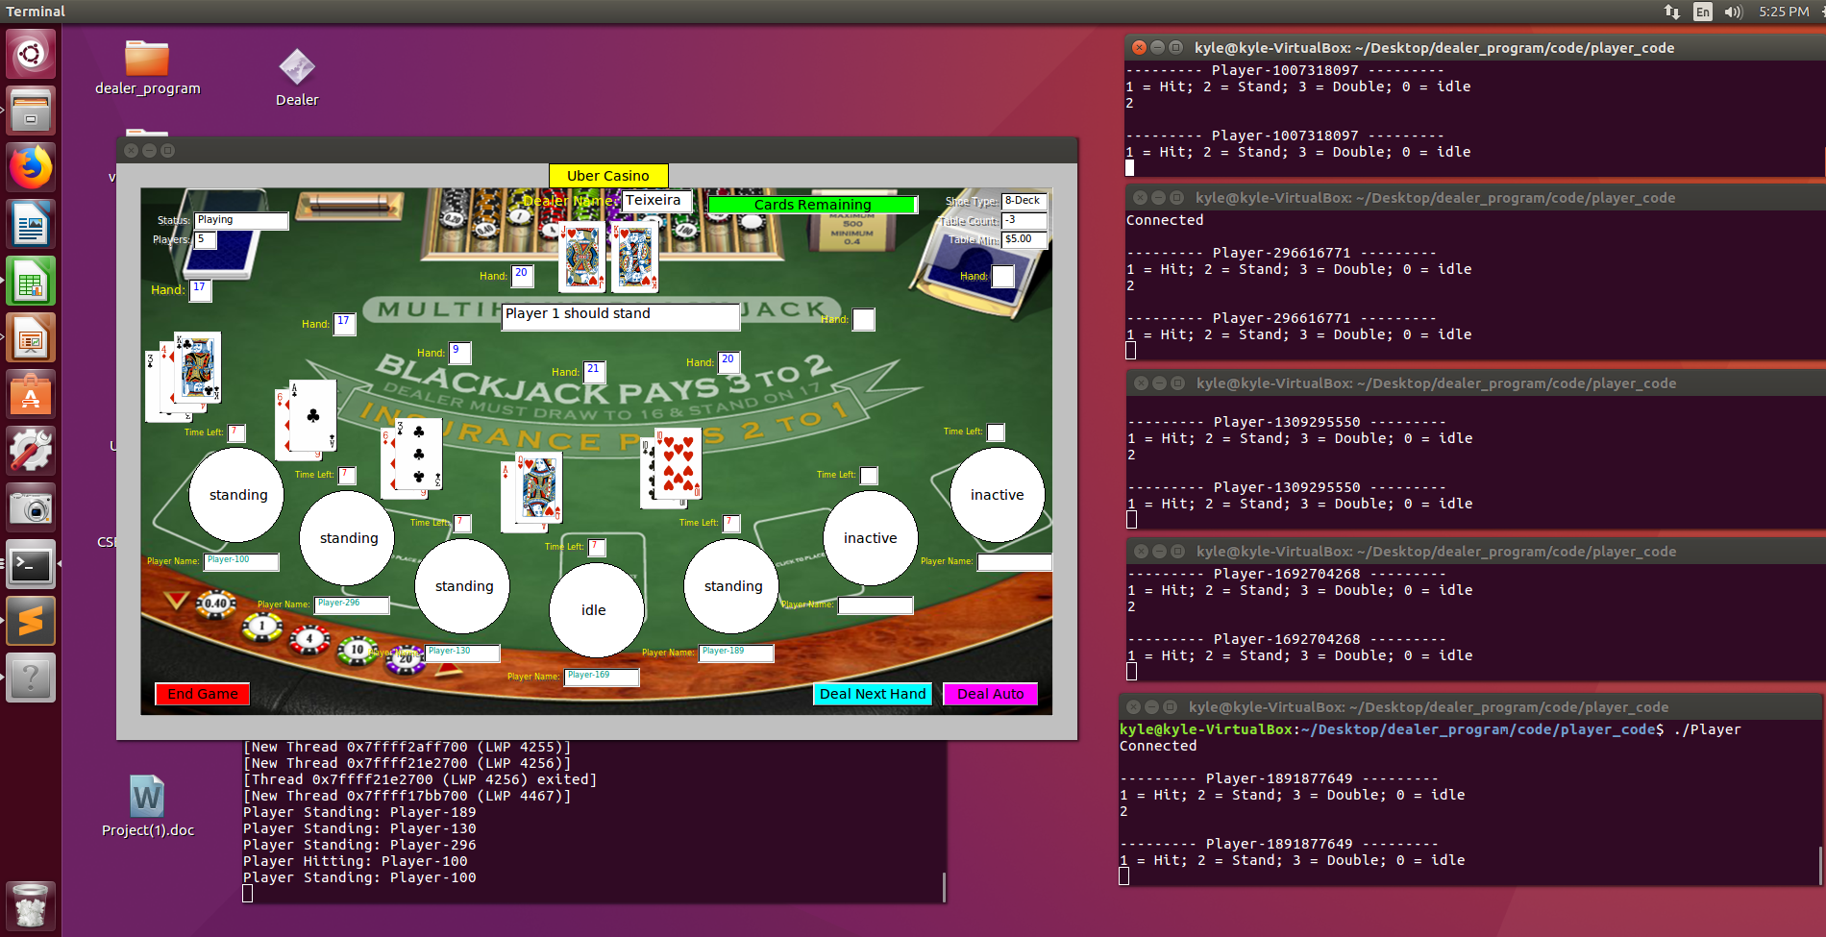
Dealer vs Player

Slide 12
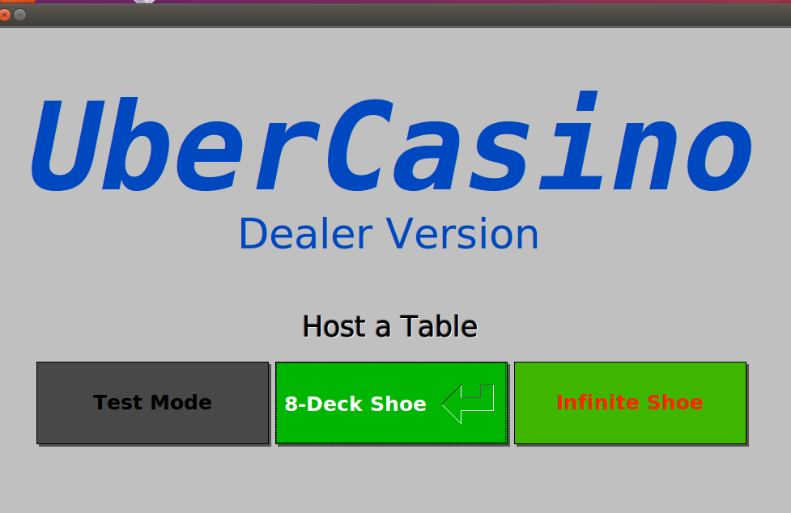
Open Screen

Slide 13
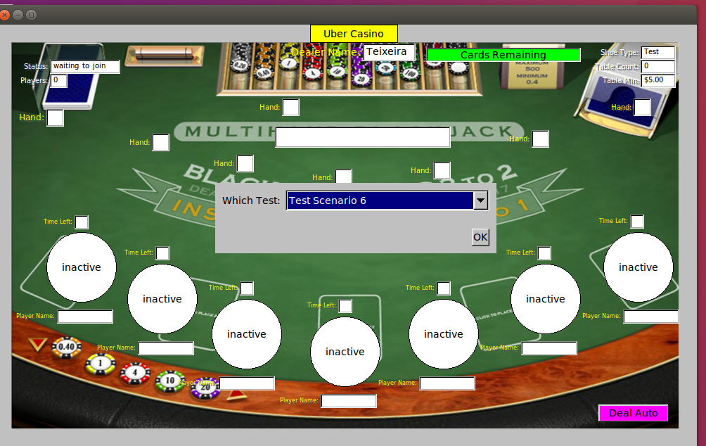
Test Suite Example

Slide 14
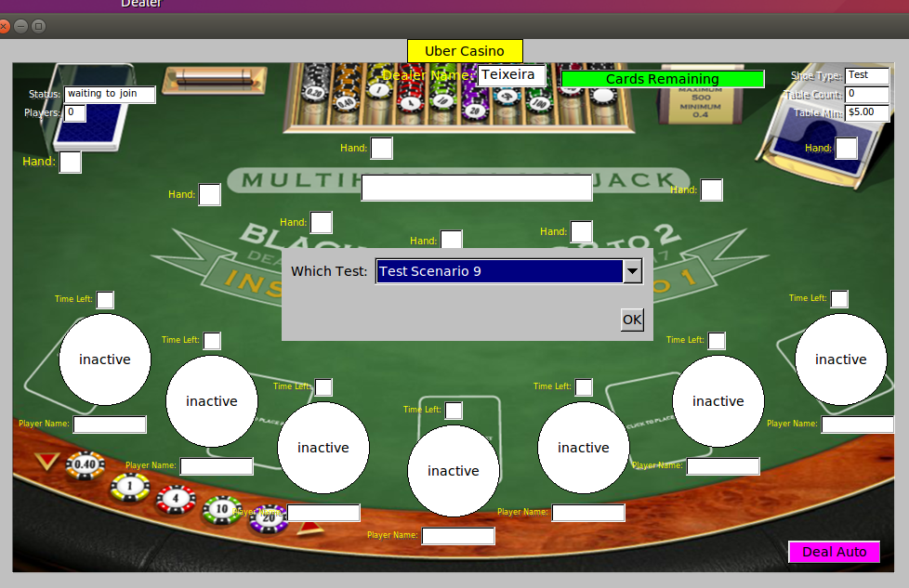
Test Suite Example

Slide 15
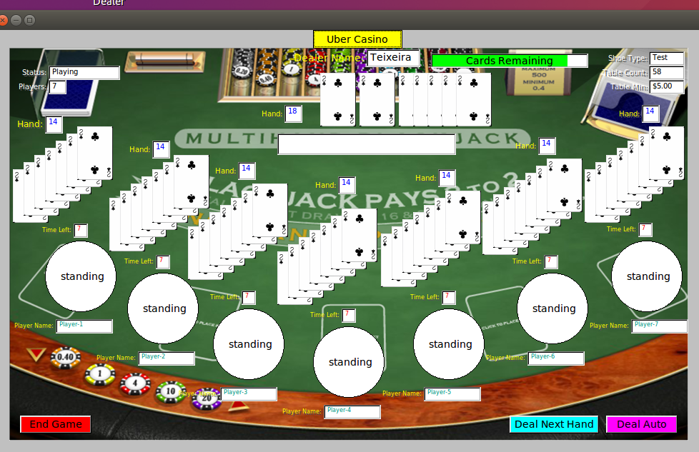
Test Suite Example

